Slide 1

Data Analysis of the Metropolis School District
Bryan Oyuela

Slide 2
Summary of Project
Purpose
To gain better understanding of the data relevant to the Metropolis school district and its possible implications
Process
Analyze key data points using Excel to tackle the district’s concerns along with other interesting analyses
Outcome
Recommendations for gender, English language learners, and special education based on analyses

Slide 3
Table of contents
01
02
03
Understanding this Project
Understanding the data and objectives relevant to this project
Analysis and Visualizations
Explanation of calculations and analysis
Recommendations
Recommendations based on trends and analysis conducted

Slide 4
01
Understanding this Project
Understanding the data and objectives relevant to this project

Slide 5
6,910
25,000+
2,570
Unique Applicants
Total applications sent to all schools in the district
Unique applicants who applied to priority schools

Slide 6
The Task
Create a table that includes information that were requested for ten priority schools
Further investigate other trends and search for interesting correlations

Slide 7
Analysis Done
Requested Analysis
Additional Analysis
# Of students that applied for each grade
% Of students who ranked the school first
Gender distribution of all applicants to the school
Average Priority ID of all applicants to the school
Ranking of schools by their average Priority ID
Most common neighborhood for applicants who ranked the school first or second
Students who applied for a school but not the other ten listed
Breakdown of ELL applicants
Schools receiving the highest # of Special Education applicants
Breakdown of current schools of applicants by grade

Slide 8
The Ten Priority Schools
Dwight Elementary School (231)
Davis Elementary School (221)
Abraham Elementary School (202)
Garvey Elementary School (259)
Smith School (943)
Joyner-Kersee Elementary School (271)
Polk Elementary School (321)
Brent Elementary School (212)
Buchanan Elementary School (204D)
Pierce Elementary School (295)

Slide 9
Why is it important to analyze this data?
Provides focus
This analysis will help provide an idea of where the district should invest its resources for maximum impact
Better understanding of demographics
This analysis will also provide interesting demographical conclusions worth investigating

Slide 10
02
Analysis and Visualization
Explanation of calculations and analysis

Slide 11
Requested Data

Slide 12
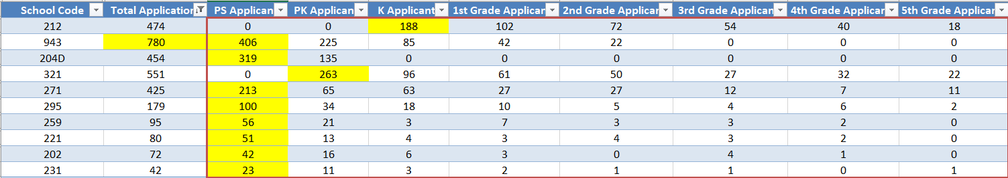
Applications per Grade by School
Most applicants were applying for Pre-School (1,210)
Pre-Kindergarten applications were the 2nd most popular grade (783)
Smith School received 406 applications to Pre-School
33.6% of all Pre-School applicants
Also received the most applications of all schools (780)

Slide 13
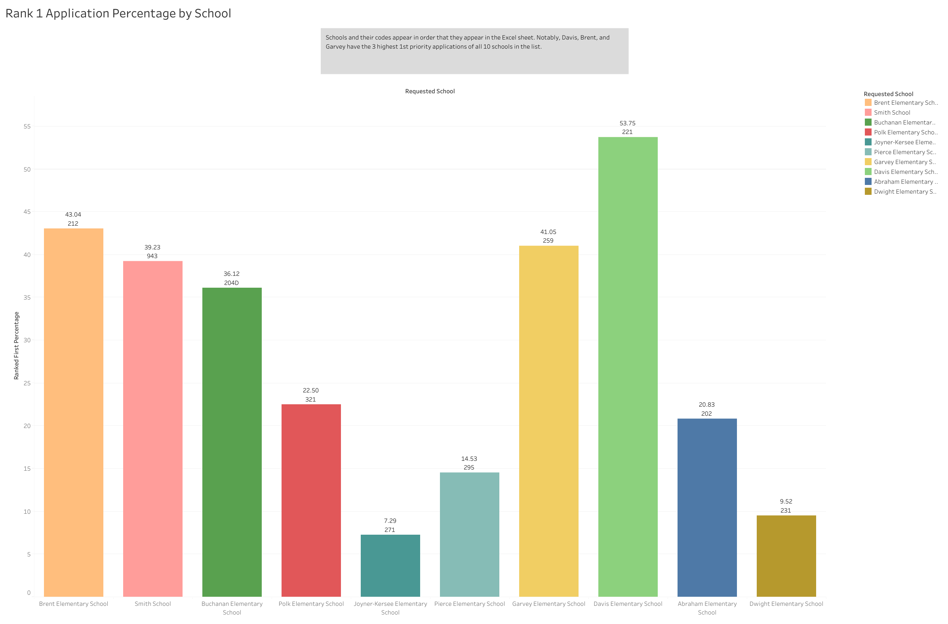

Slide 14
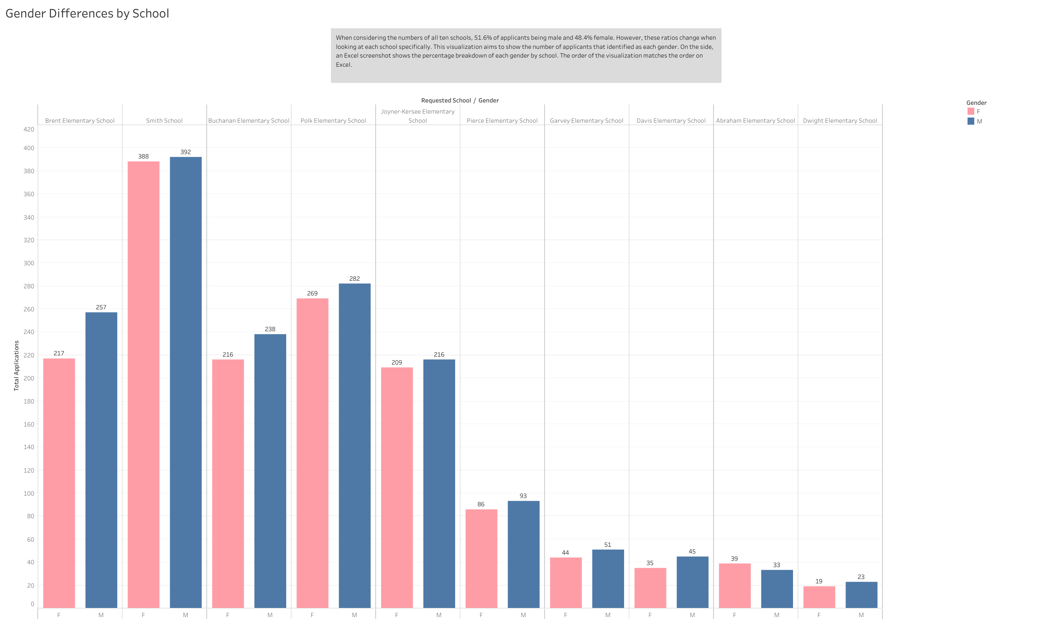
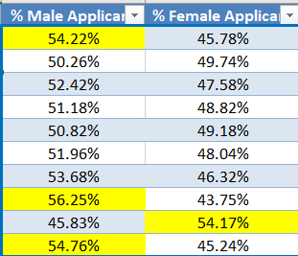
NOTE: Numbers highlighted in yellow are percentages that exceeded a 5% difference between genders

Slide 15
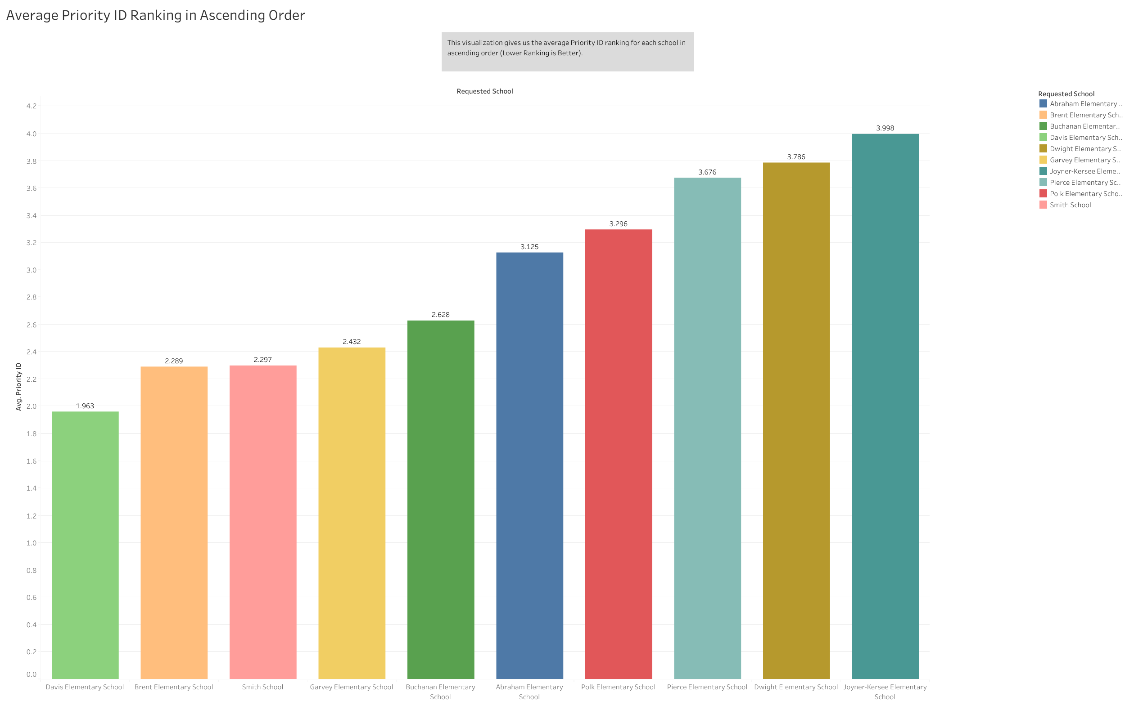

Slide 16
Neighborhood Ranking First or Second
Zone 7 appeared 4 times as the most common neighborhood applying with 1st and 2nd priority
Zone 6 was a close second most common (appeared 3 times)
School Name | Most Common Neighborhood
Brent Elementary | 6
Smith School | 6
Buchanan Elementary | 1
Polk Elementary | 3
Joyner-Kersee Elementary | 8
Pierce Elementary | 6
Garvey Elementary | 7
Davis Elementary | 7
Abraham Elementary | 7
Dwight Elementary | 7

Slide 17
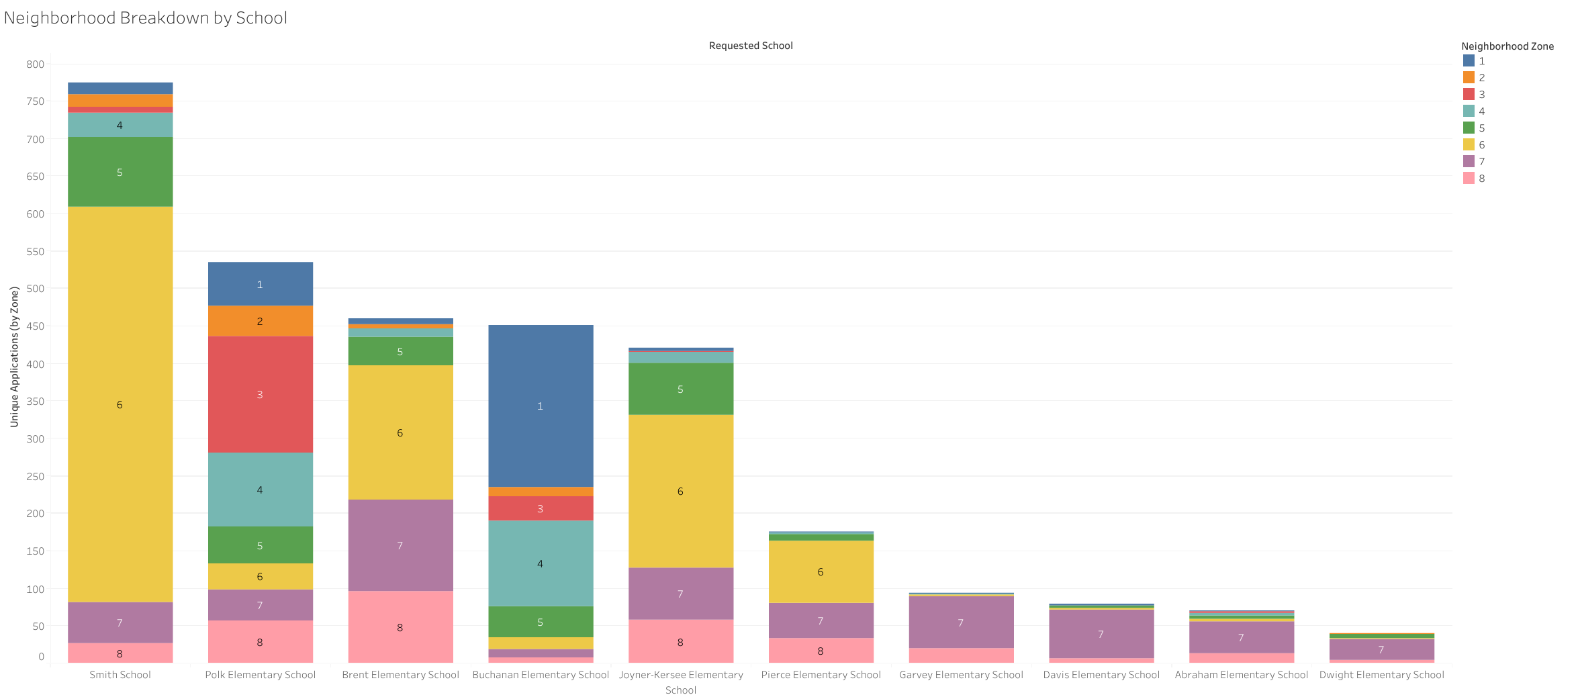

Slide 18
Exclusive Applicants for Each School
Smith, Buchanan, and Polk held were the 3 schools with the highest exclusive applicants
This is probably due to their high application counts compared to that of other schools
School Name | Did Not Apply For Other Priority
Brent Elementary | 253
Smith School | 491
Buchanan Elementary | 422
Polk Elementary | 469
Joyner-Kersee Elementary | 178
Pierce Elementary | 88
Garvey Elementary | 75
Davis Elementary | 43
Abraham Elementary | 37
Dwight Elementary | 19

Slide 19
Additional Analysis

Slide 20
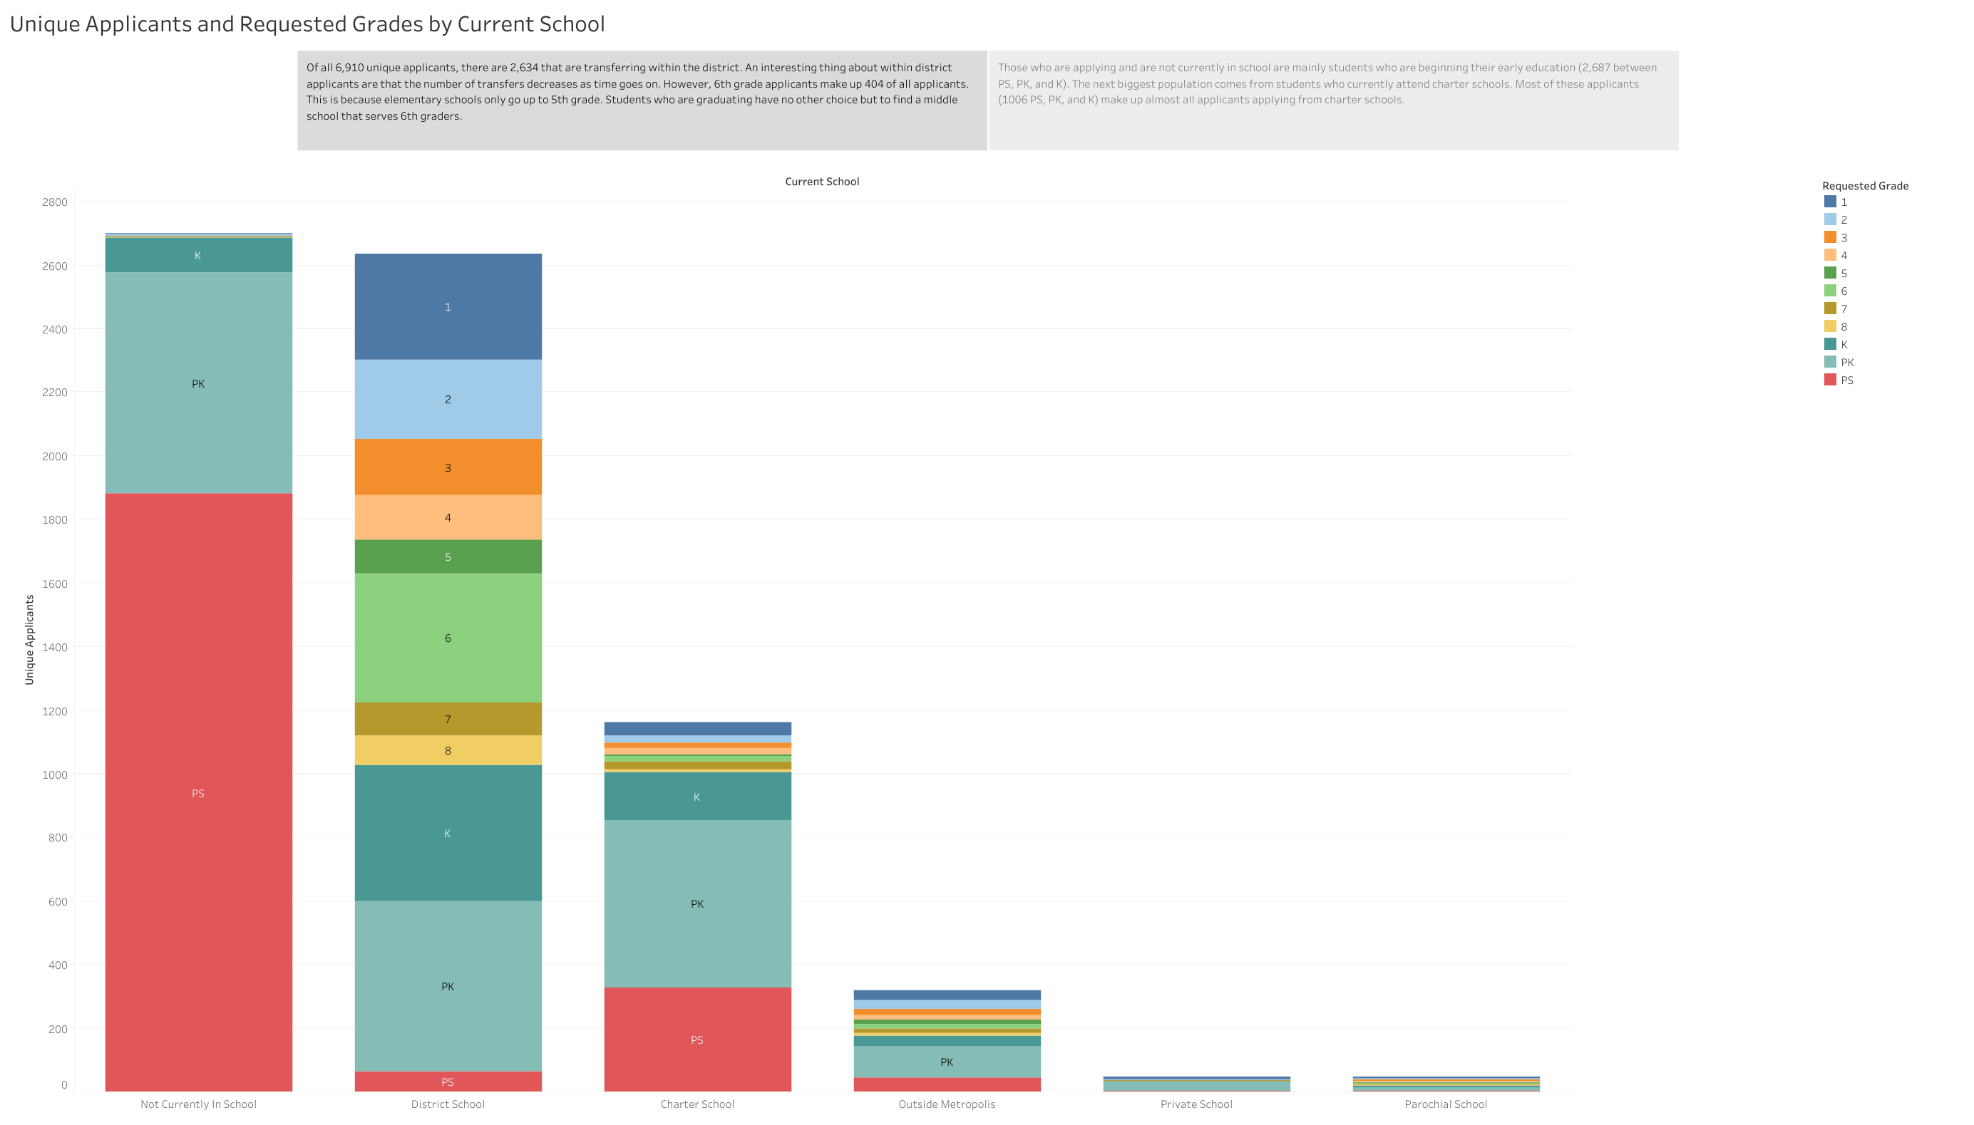
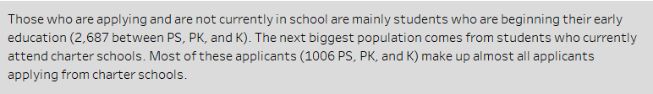

Slide 21
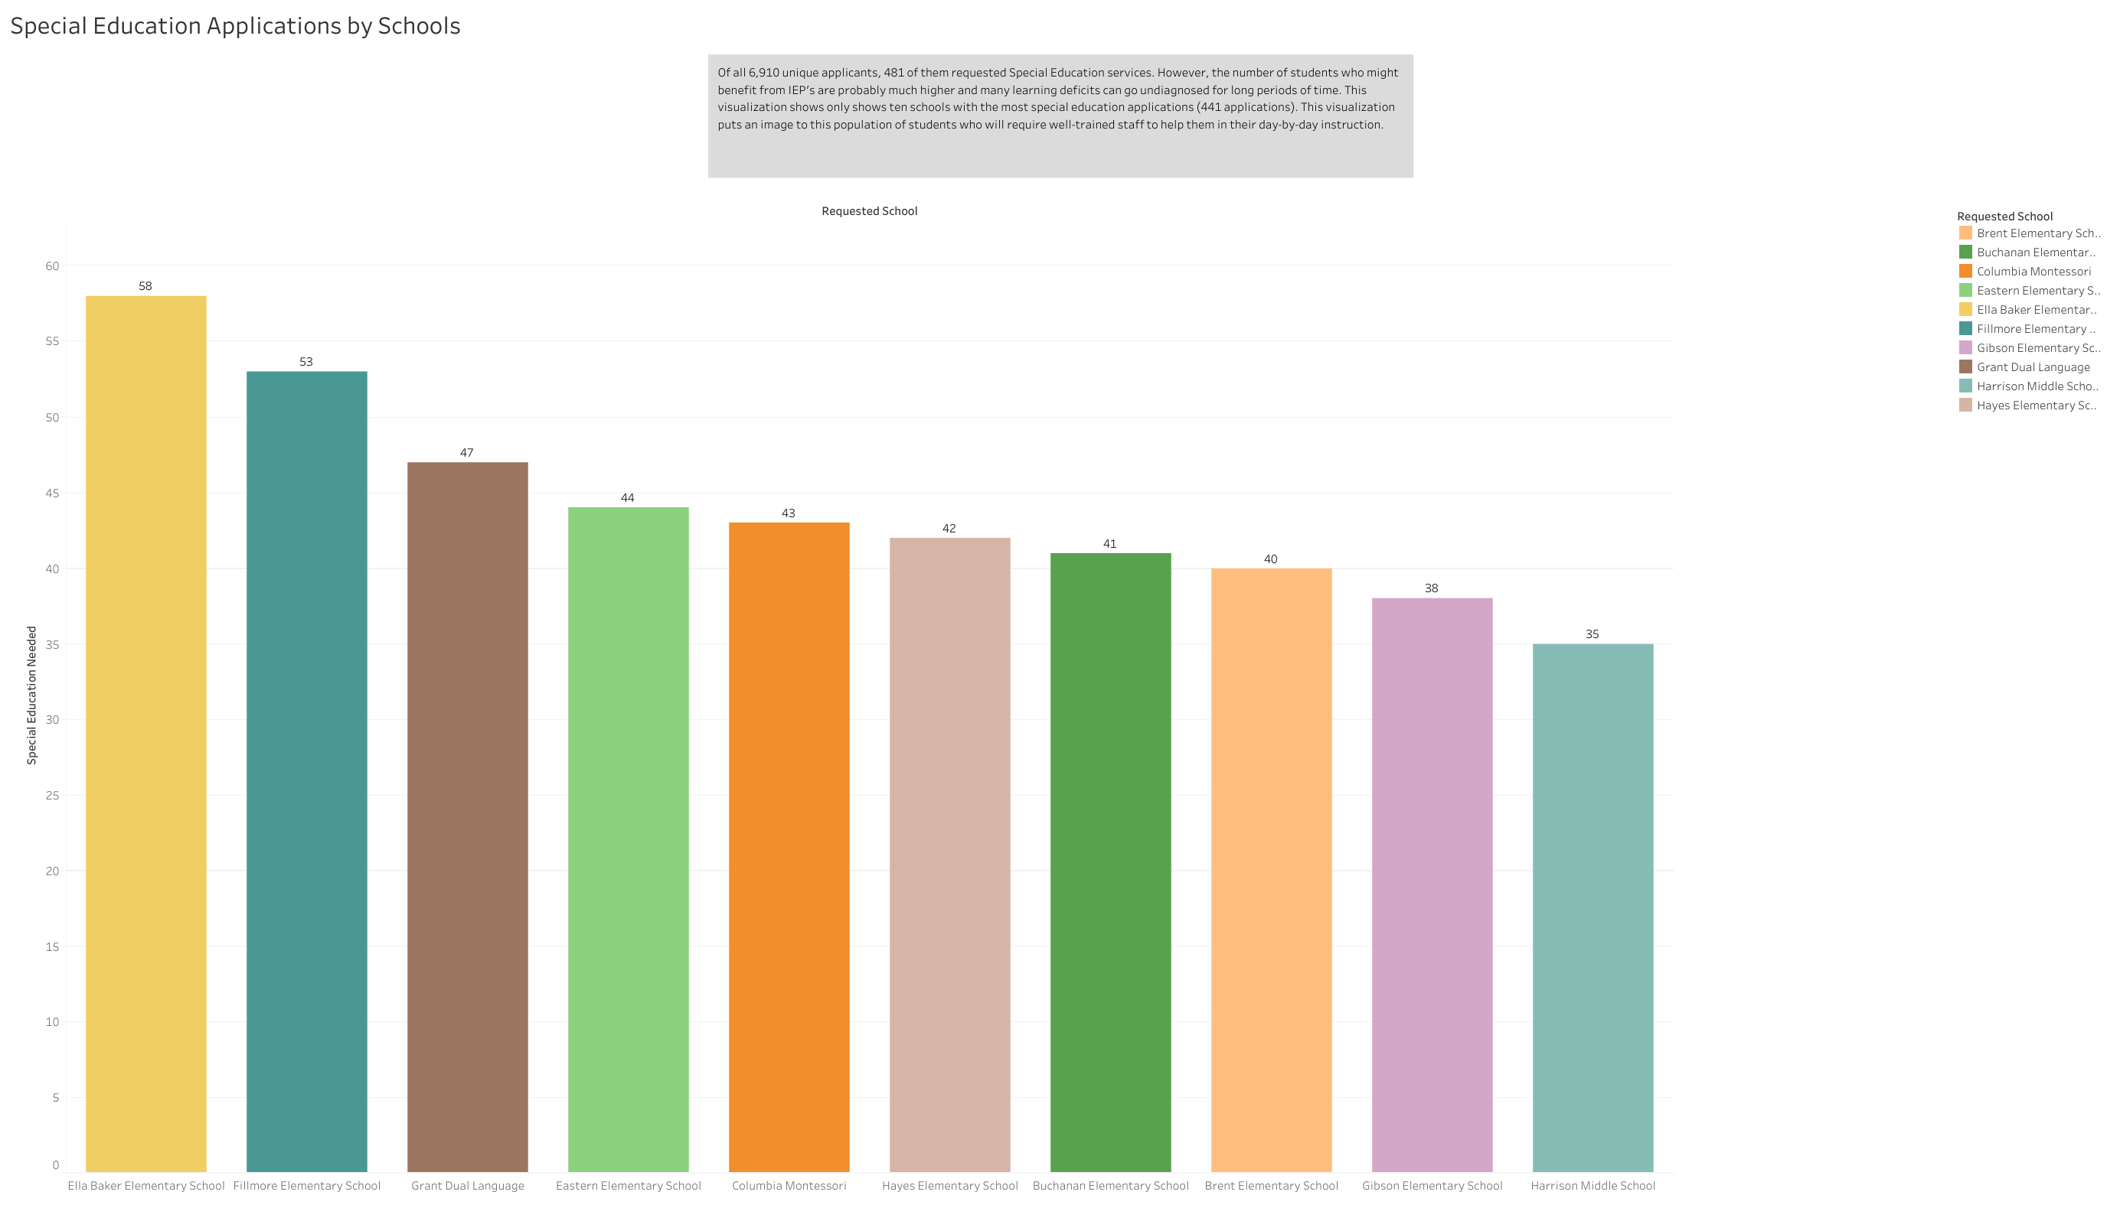

Slide 22
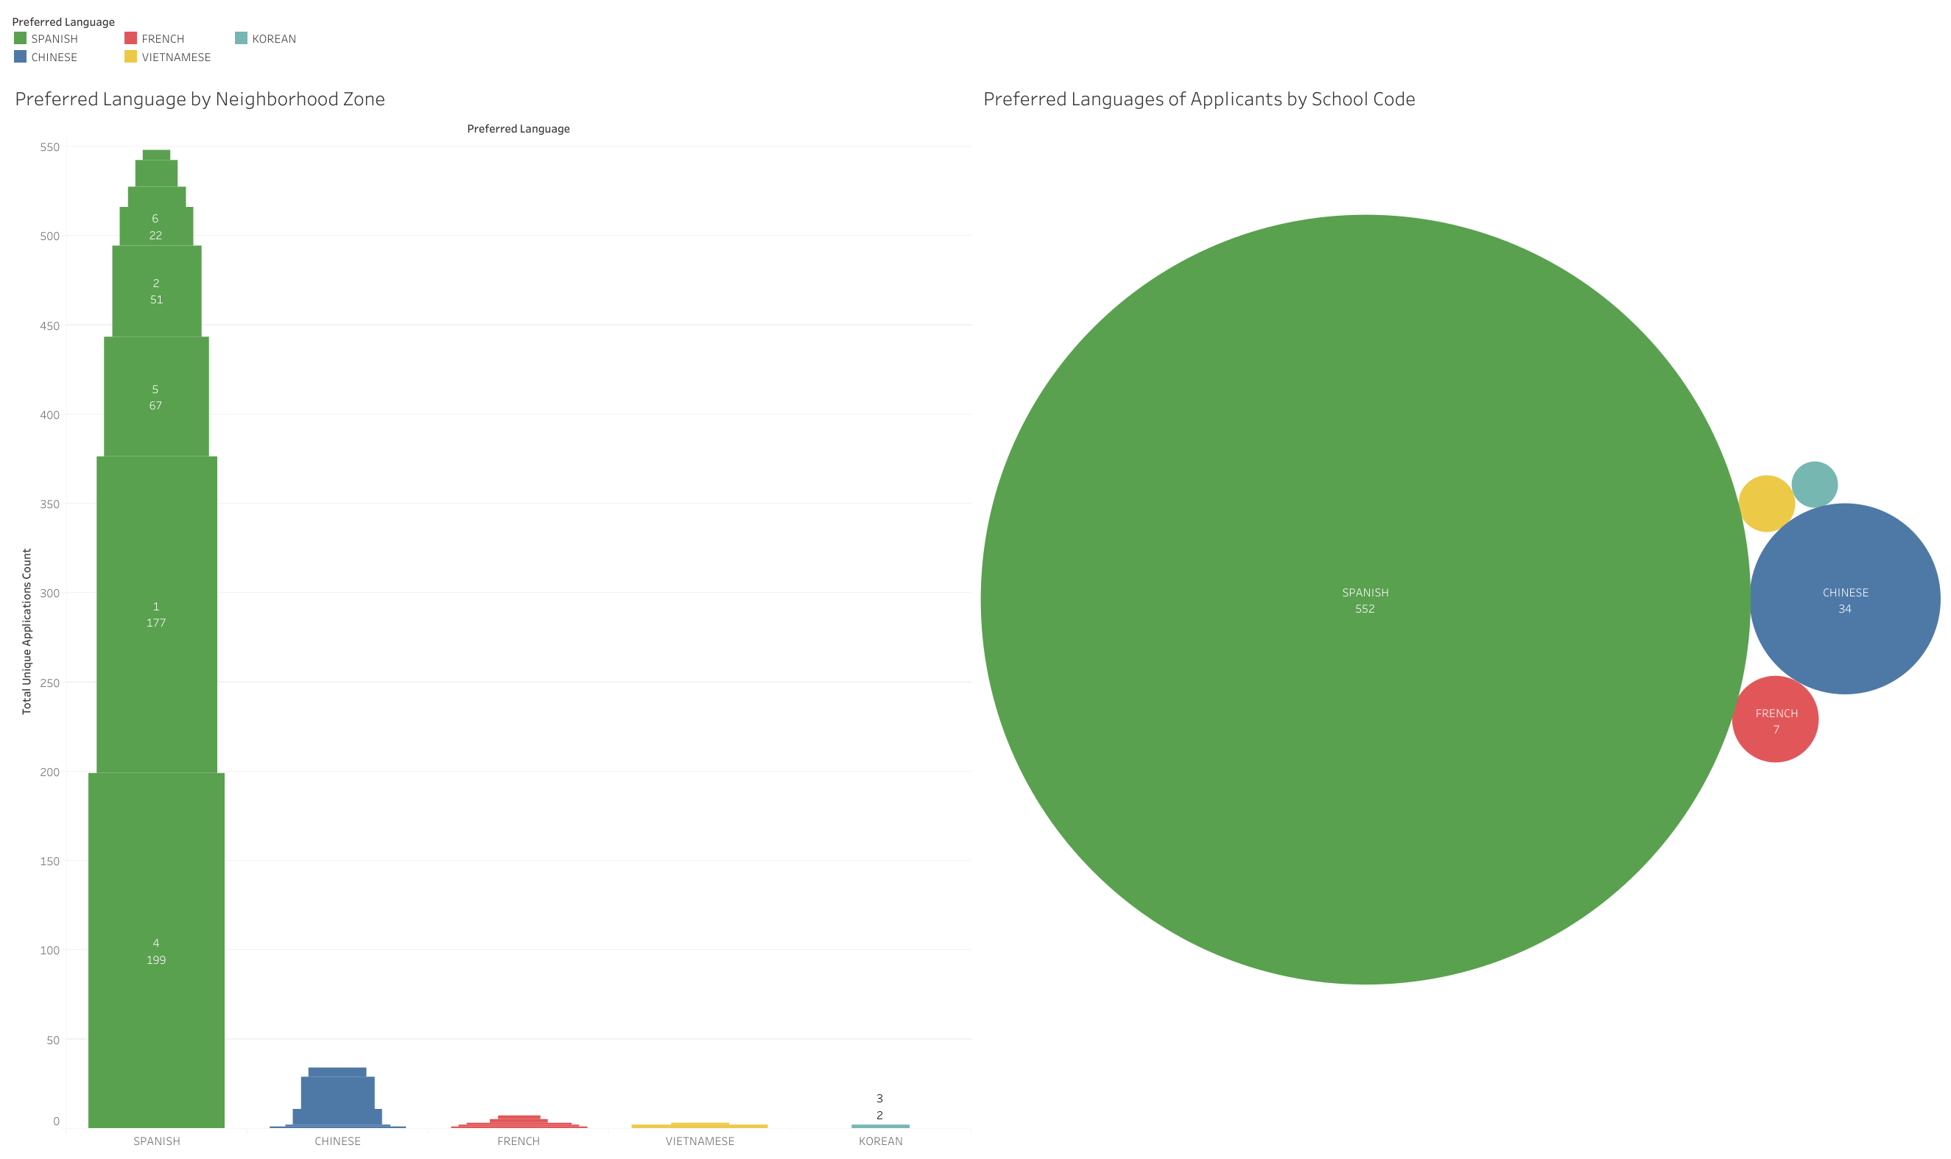

Slide 23
03
Recommendations
Recommendations based on trends and analysis conducted

Slide 24
Recommendations for Further Action
Demographics
Gender Gaps
Gain a better understanding of the demographics of students applying from Neighborhoods 6 and 7
Investigate why school codes 212, 259, 221, 202, and 231 have gender gaps above 5%
Special Education
English-Language Learners
Invest in bolstering resources for students requiring special education
Invest in attracting multi-lingual staff who can aid ELL students (especially Spanish-fluent staff)

Slide 25
Thanks!
Please take this time to ask clarifying questions, provide feedback, or request more analysis!
Please keep this slide for the attribution

